Slide 1
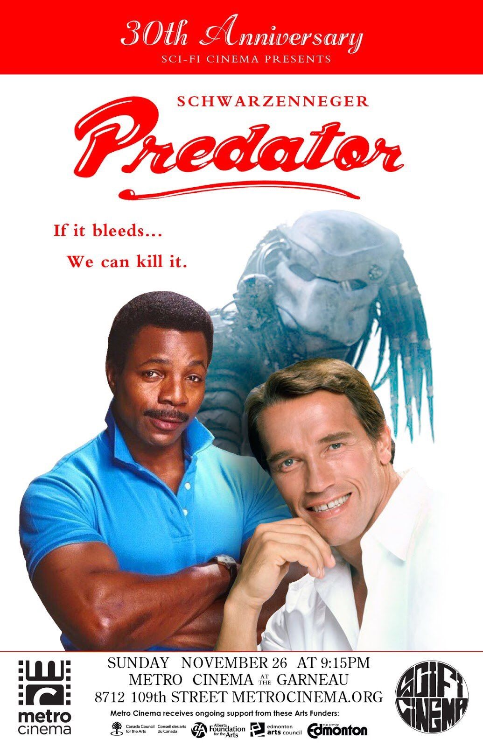


Unconventional Game Design
with Smumbo

Slide 2

Announcements!
3/22 - TBA
3/29 - Multiplayer games with Drew Castalia

Slide 3
What’s the deal?

Slide 4
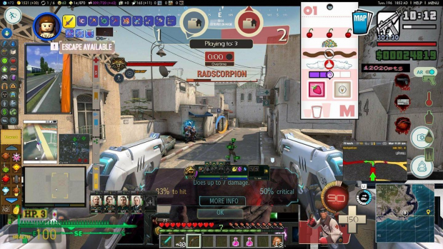

Conventional Game Design
boring
repetitive
predictable
exploitative
yeah

Slide 5
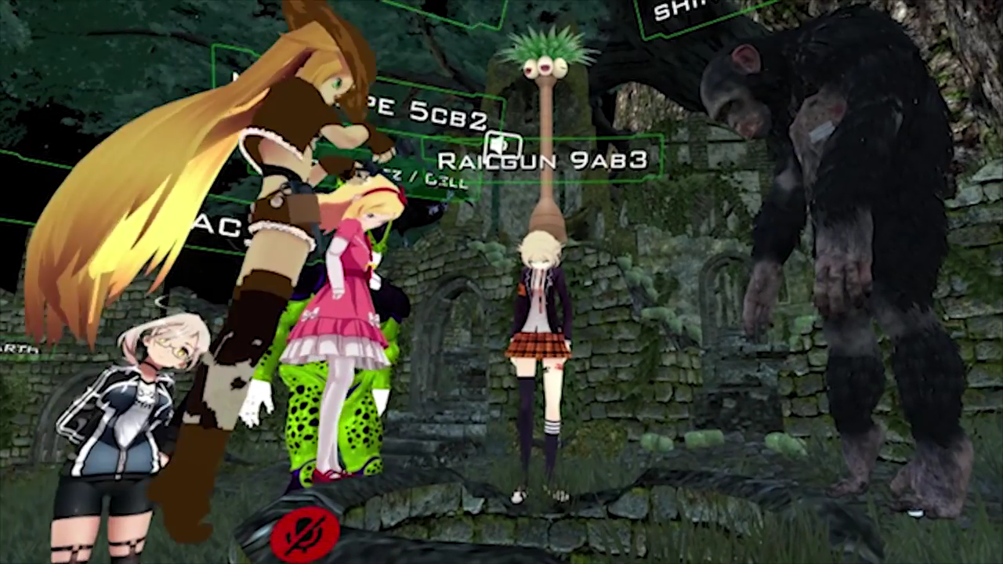

Adventurous Indies
Interesting!
Fun!
Unpredictable!
Political!
Aesthetic!
uhh!

Slide 6

but surely, we could get even more adventurous and unconventional

Slide 7

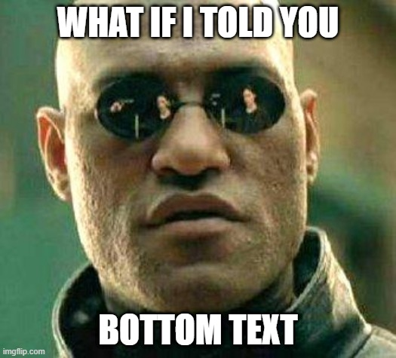
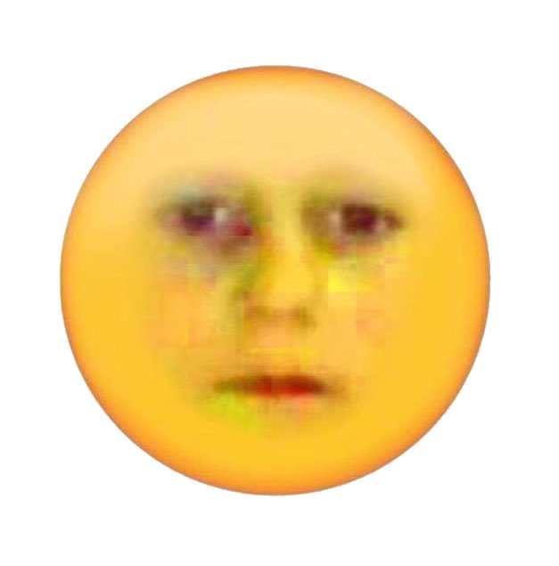
:O
i wanna go higher
what if we changed not only the ways in which games are played,
but also the way in which they are made?

Slide 8


Unconventional Game Design
with Smumbo

Slide 9
Explanation

Slide 10
Unconventional vs Experimental
Disambiguation:
For the purposes of this talk:
Unconventional:
Created using tools not intended to be used for creating games.
Experimental:
Features non-standard game mechanics, visuals, and/or input methods.
These aren’t mutually exclusive, but we’re concerned about unconventional games right now.

Slide 11
Drawbacks!
You will be beholden to the capabilities and design of your chosen tools
Probably can’t sell many games made this way
Performance issues
yeah

Slide 12
Benefits!
You will be beholden to the capabilities and design of your chosen tools
(forces you to be creative)
“Easier” to make than normal games
Fun to stretch the capabilities of software
(Usually) no standards to compare your game against

Slide 13
Game Examples

Slide 14
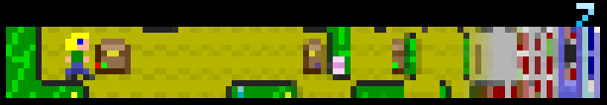
a mild example
Passage (2007), Jason Rohrer
Extremely low resolution (100 x 16)
Short length (5 minutes)
Simple controls (4 directions)
Made me cry a little bit
hcsoftware.sourceforge.net/passage

Slide 15
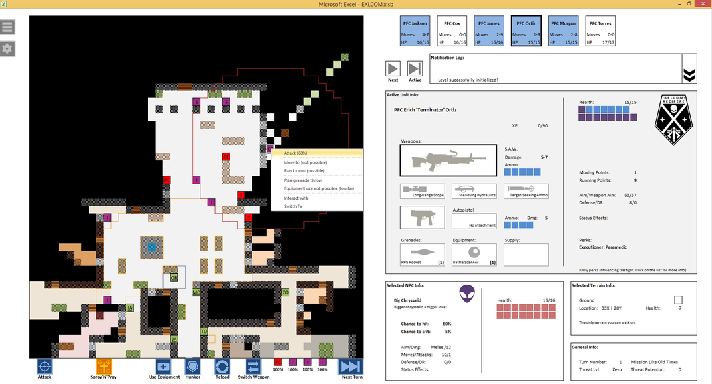
getting weirder
EXLCOM (2015), crruzi
XCOM for Microsoft Excel
Made with Visual Basic for Applications
I don’t play strategy games, I couldn’t figure out how to play it lmao
exlcom.jimdofree.com

Slide 16
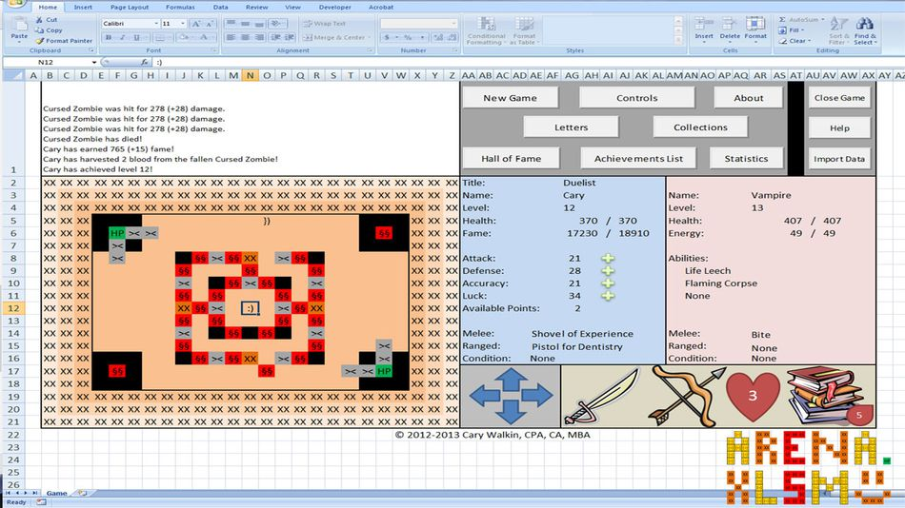
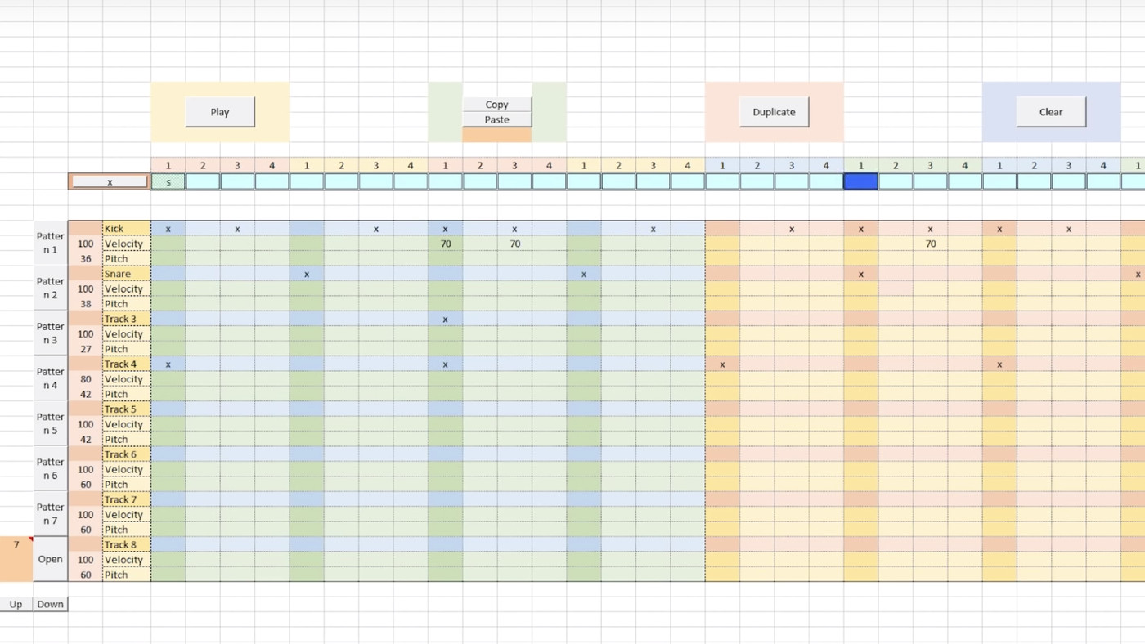
An aside: Excel is really cool!
Arena.Xlsm (2013), Cary Walkin
xlStudio (2020), Dylan Tallchief
carywalkin.ca/download-arena-xlsm
github.com/DylanTallchiefGit/xlStudio

Slide 17
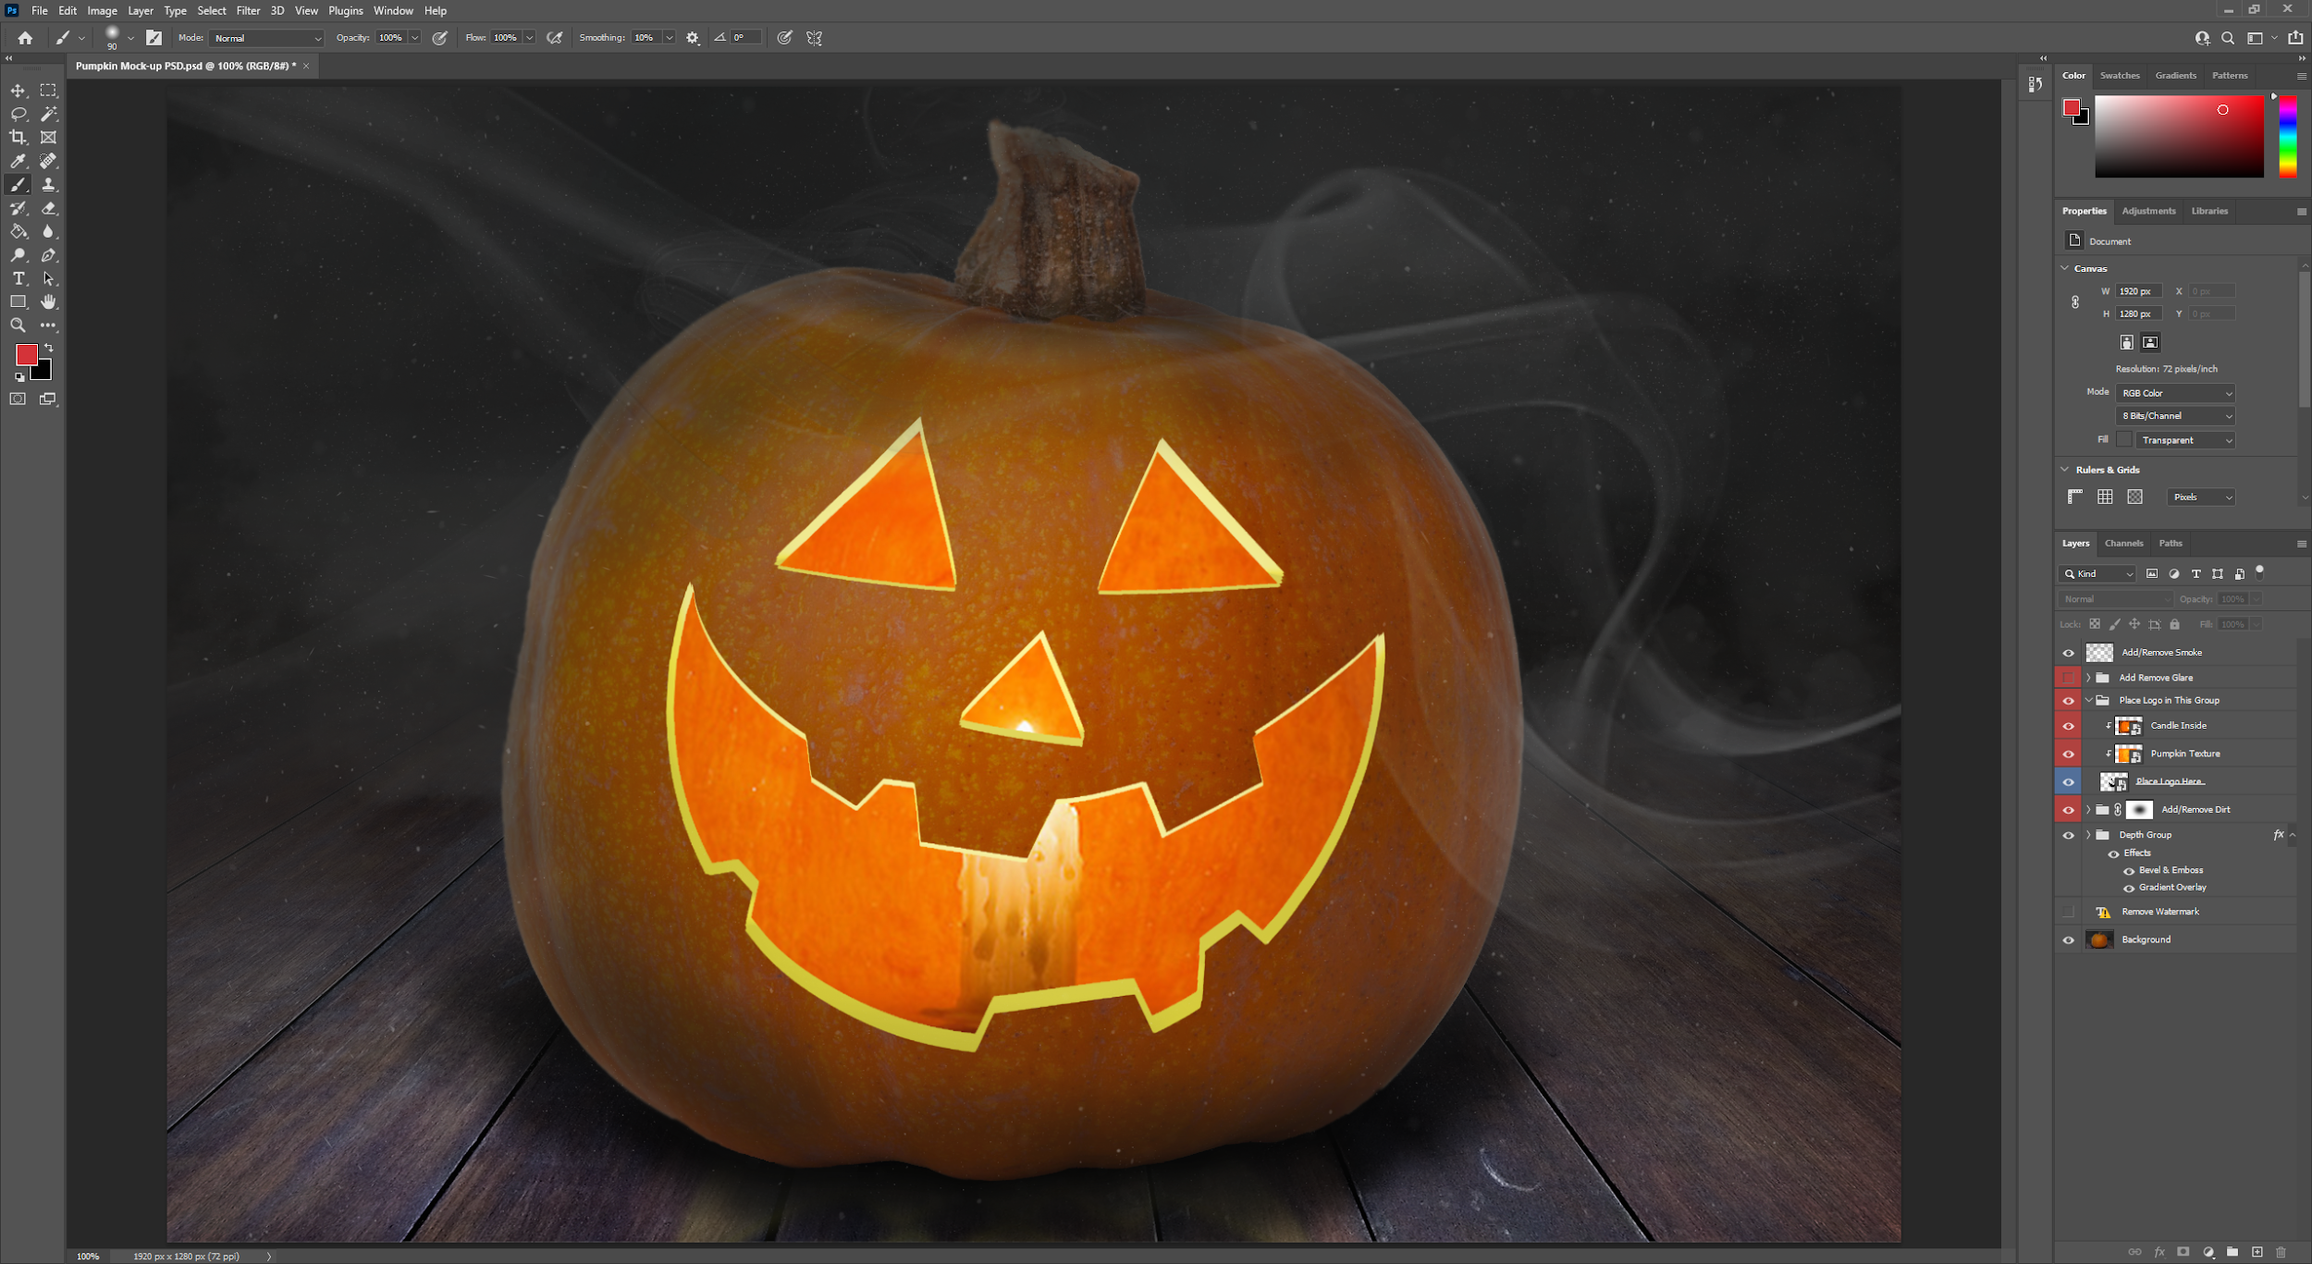
Unconventional seasonal fun
Pumpkin carving with Adobe Photoshop!
Not sure who originally made this idea
Inside/outside layers, “carved” out by drawing on a clipping mask
Add effects and overlays to make it prettier using Photoshop magic

Slide 18

now we’re talkin
Flappy Braille (2014), ilesinge
Flappy Bird, but in your address bar
Represented with braille characters
Can be played on any webpage!?
flappybraille.ndre.gr
If you noticed the talkin/walkin thing between this slide and the last one umm that’s cool i guess idk why i’m making such a big deal out of this

Slide 19
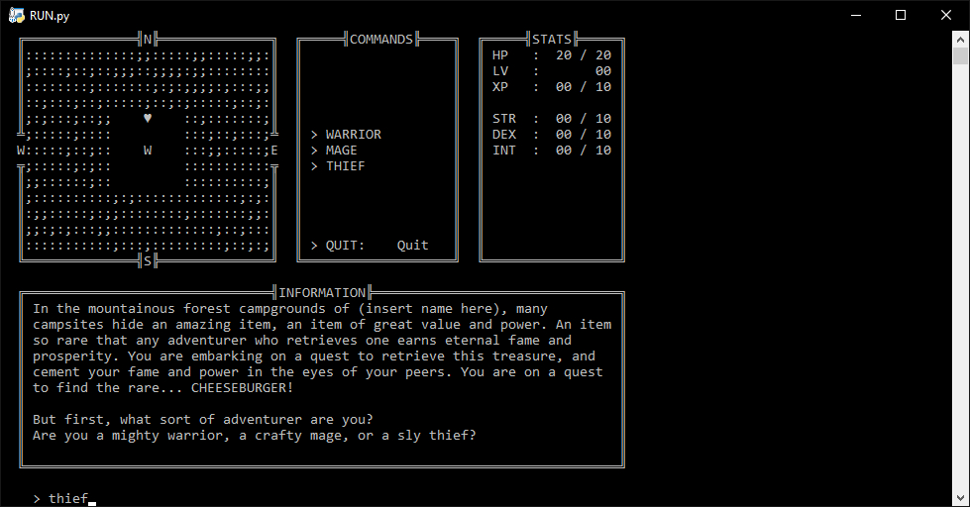
shameless self-insert
CheeseBearger (2019)
Made by: Peter Bedrick, Jade Marmorstein, Paul Rogers, & Jonah Venglarcik (that’s me)
Made for a game jam (theme: “bare minimum”)
smumbo.itch.io/cheesebearger
Text RPG created with Python 3.7
UI framework, commands, combat, and dialog are all code-driven. No libraries.
Runs right on the command line
Entire “UI” is pushed up and replaced after each action

Slide 20
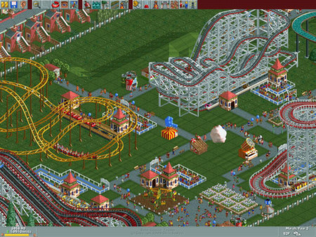
Bet you didn’t know this one
RollerCoaster Tycoon (1999), Chris Sawyer
Critically acclaimed and beloved amusement park tycoon game
Created entirely with x86 assembly language
Also just one guy made it???
store.steampowered.com/app/285310/RollerCoaster_Tycoon_Deluxe

Slide 21
Conclusion
Unconventional game design is very cool and good
It’s as easy or difficult as you want it to be - be creative
Expand/reveal the capabilities of your favorite software
Use software that you’re familiar with
You’re (sort of) in control of the framework
Your game probably won’t be judged very harshly
People are excited to see things done unconventionally

Slide 22


